Slide 1
Wood shop safety

Slide 2
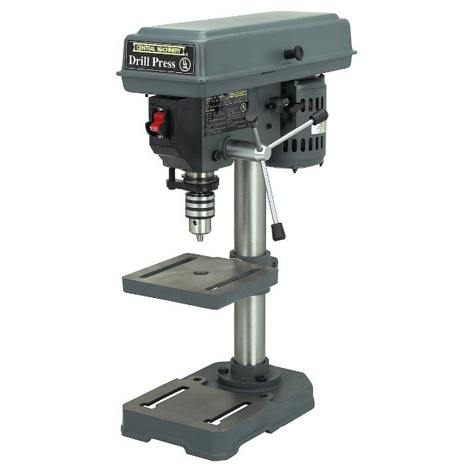
Basic rules
Wear goggles if you are near or using any power tool or anything that could cause small pieces to fly into the air. PROTECT YOUR EYES.
Be sure the area around you is clear.
Don’t talk with a person who is using a power tool until they finish
Check all parts before turning on power.
Turn off power as soon as finished.
NO horseplay:
Throwing/tossing things
Chasing/poking each other
Any immature, foolish act that could unintentionally cause harm.

Slide 3
DRILL PRESS
The drill press is an excellent machine for drilling accurate holes and is invaluable when drilling large holes. It consists of a motor/head assembly, chuck, and work table. Only to be used for drilling holes.
1. The procedure of changing spindle speed varies from drill press to drill press. Check with your instructor prior to making speed adjustments.
2. Be certain that the table and head of the drill press are secure.
3. Select the proper drill bit for the job and avoid dull bits.

Slide 4
4. Insert the drill bit in the chuck properly and tighten it securely before starting the drill press.
5. Remove the chuck key before turning on the power and before leaving the area of the drill press. If the chuck key is not removed it will be thrown out from the chuck at a tremendous speed when the power is turned on.
6. Use clamps or a drill vise whenever necessary to secure small or odd shaped work firmly.
7. Larger bits should be run at slower speeds and smaller bits at higher speeds. This keeps the cutting edge of the bit at a reasonable speed.

Slide 5
8. Use a backer board under the work or be sure the bit is over the center hole in the table when boring completely through your work.
9. Keep hands away from the rotating spindle.
10. Operate the feed lever so that drill cuts at a consistent feed rate into work.
11. Ease up on feed pressure when the bit begins to break through the work.
12. Back the bit out often to clear chips from the hole.

Slide 6
13. When boring to a given depth, use the depth adjustment nut or feature.
14. Stop the drill press before removing your work.
15. If work comes loose and is seized by the drill press, shut off the power immediately if you can do so without endangering yourself. If it is impossible to shut off the power, move away from the machine and move others away. Notify the instructor immediately

